Slide 1
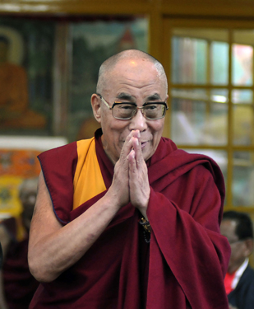
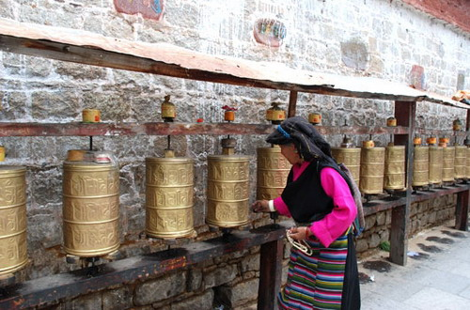
Tibetans in India
An example of International Migration………………
This is about the Tibetans forced to migrate as there were disputes between china settling there and due to the other political issues.

Slide 2
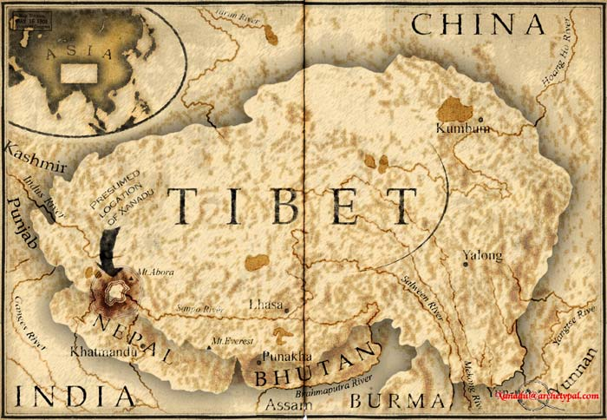

Slide 3
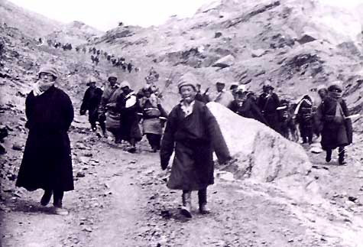
Introduction
Tibetans started coming to India in 1957. They initially got legal registration to come into India and stay. Tibetans had many reasons to come into India such as education, job opportunities, lack of freedom etc. Tibetans came by crossing the Himalayan range into India and settled into 57 settlements. They started doing many kinds of jobs which were low paid and weren’t requiring a lot of skill. Then later on Indians and Tibetans started to have problems.

Slide 4
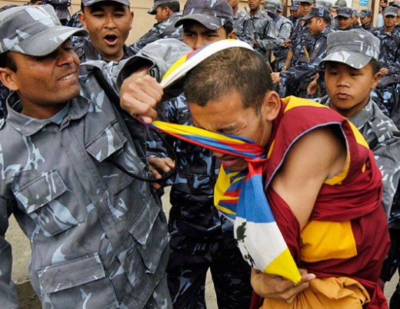
Why Tibetans came to India?
China’s Invasion into Tibet
Job opportunities
Education
Religious freedom and education

Slide 5
When Tibetans came to India?
First Wave
During the 1959 Tibetan uprising, the 14th Dalai Lama and some of his government fled to India. Initially 80,000 Tibetans migrated to India
Tibetans followed the Dalai Lama to India through the Himalayas.
Continued flights, estimated in the numbers of 1,000 to 2,500 per annum, increased these numbers from 80,000 to 100,000 and still increasing.

Slide 6
Second Wave…..
After the opening of Tibet in the 1980s to trade and tourism, a second Tibetan wave of exile took place due to increasing political repression. 25,000 came to India in 10 years.
Tibetans joined and increased by 18% their exiled community in India.
From 1980 to November 2009, 87,096 Tibetans arrived in India and registered at the Dharamsala reception centre, whereas 46,620 returned to Tibet after a pilgrimage in 1959 in India.
Most of those staying are children to attend Tibetan Children's Villages school.

Slide 7
Present Immigration
A 2008 documentary directed by Richard Martini claimed that 3,000–4,500 Tibetans arrive at Dharamsala every year.
Most new immigrants are children who are sent to Tibetan cultural schools, sometimes with the tacit approval of the Chinese government.
Many political activists, including monks, have also crossed over through Nepal to India.

Slide 8
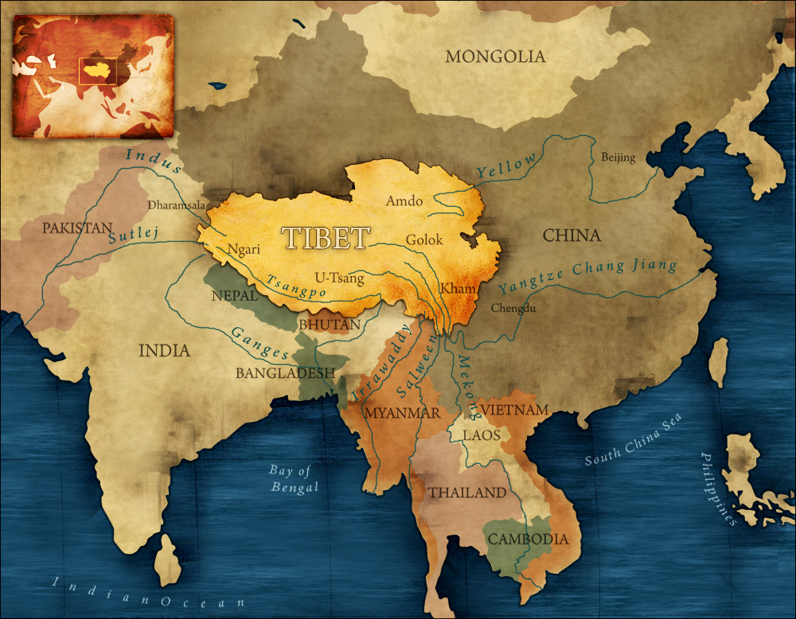

Slide 9
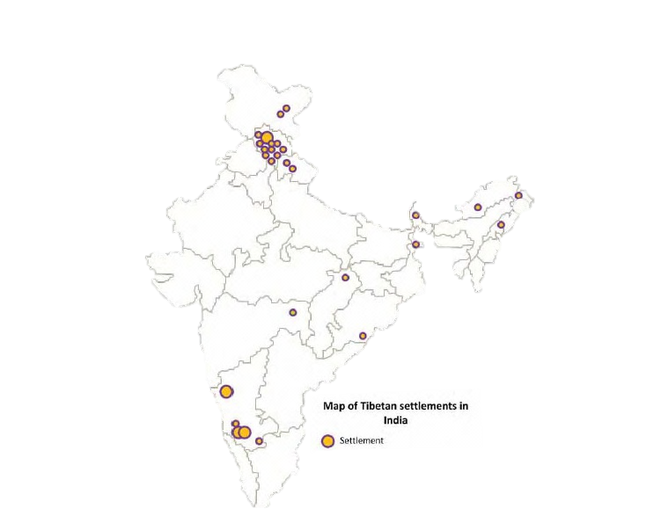

Slide 10
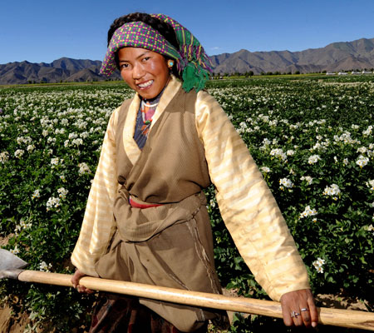
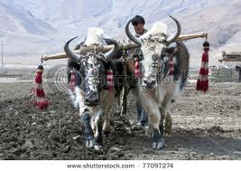
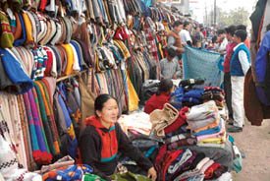
Occupation

Slide 11
Socio – Economic Conditions
Tibetans in India live in 37 different settlements and 70 scattered communities in Himachal Pradesh, Ladakh, Arunachal Pradesh, Karnataka, Uttar Pradesh, Madhya Pradesh, South Sikkim, West Bengal, Maharashtra and Orissa.
Of the settlements, just under half are based on agriculture, while one-third are agro-industrial and a fifth are handicraft-based.
The scattered communities consist of smaller groups of Tibetans outside of the official settlements who were not willing, or not able, due to limited resources, to be accommodated in the settlements.
Tibetans are given more rights than most other refugee groups in India. They are provided with residence permits, which enable them to seek formal employment.

Slide 12
Limitations to Tibet Diaspora
In India, the heavy inflow of new arrivals has become one of the most pressing policy issues confronting the government-in-exile.
As India has limited resources to provide a population of 1.2 billion, India is requesting to Dalai Lama to stop the immigration
Some of the Tibetans in India who arrive presently are not given the same legal status as those who arrived in the first wave. However the people who arrived in the second wave are given legal status if they prove to be born in India
Problems facing Tibetan communities in India are twofold: the increasing intolerance of the intolerance of the Indian government as it warms up to China in an environment of diminished rights for Tibetans, and the challenge of a limited and overburdened infrastructure, land and social services in the face of an expanding population and resource depletion.

Slide 13
Conflicts
Tibetans rioting to solve problem of Chinese invasion
There are many conflicts regarding Tibetans in India. The major problems are:
Indians feel now that they are heavily populated they lack resources
They break rules
They give less job opportunities to people living in India
They are allowed to study in Indian school and the teacher feels that they are lazy due to comfortable exile
cultural changes lead to splits in the country

Slide 14
Statistics
The Central Tibetan Administration (CTA) provides a Green Book - a kind of Tibetan identity certificate - to Tibetan refugees.
Based on a CTA survey from 2010, 127,935 Tibetans were registered in the Diaspora: in India 94,203; in Nepal 13,514; in Bhutan 1,298; and in rest of the world 18,920.
However, their number is estimated at up to 150,000 in 2012 in India by the 14th Dalai Lama in 2009.

Slide 15
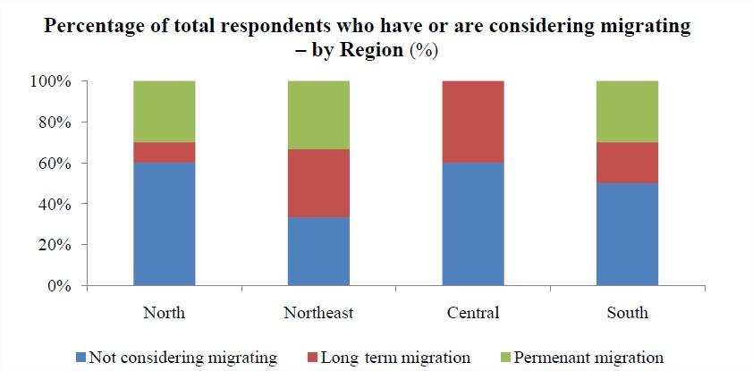

Slide 17
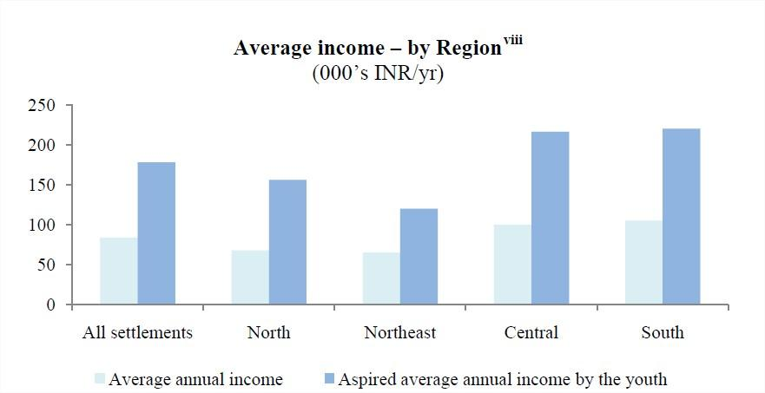
In Thousands

Slide 18
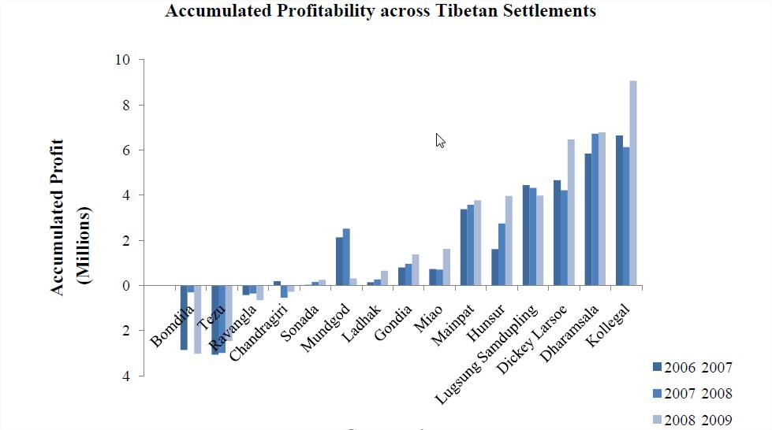
Business

Slide 19
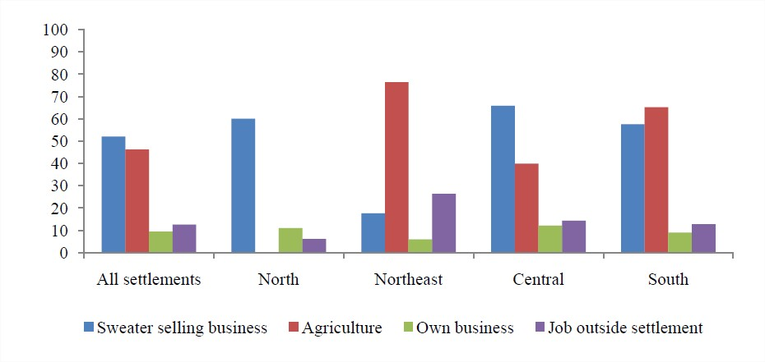
Tibetan business across India

Slide 20
Story of Manipat-Tibetan settlement in India

Slide 21
Tibetans buying land Illegally in India

Slide 22
CONTRIBUTION
Jneil | Introduction
Jheel | When & Why did Tibetans come?
Dhruvin | Occupation Research and Photos and videos
Kalpit | Limitations to Tibetans
Vatsal | Statistics
Jigar | Internal Conflicts
Mihir | Socio – Economic Conditions

Slide 23
Thank You

