Slide 2
What is obesity?
Obesity is defined as abnormal or excessive accumulation of fat which might present a risk to health.

Slide 3
What is body mass index (BMI)
The BMI is a statistical measurement derived from your height and weight.
Although it is considered to be a useful way to estimate healthy body weight, it does not measure the percentage of body fat.
The BMI measurement can sometimes be misleading

Slide 4
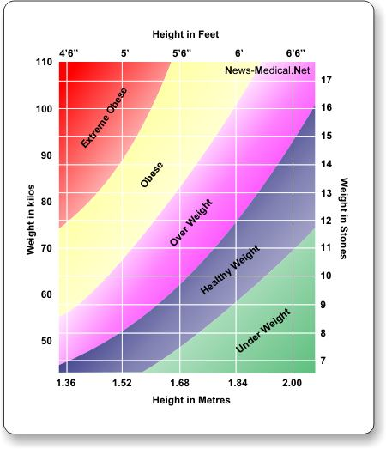
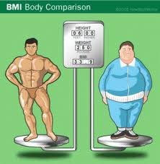

Slide 5
Why do people become obese?
Consuming too many calories:
people eat way more than needed. The diet has also changed to junk food and all the unhealthy food
Leading a effortless lifestyle:
With the arrival of modern technology which makes life easier and effortless, the majority of people are leading a much more effortless lifestyle compared to their parents and grandparents.

Slide 6
Not sleeping enough:
If you do not sleep enough your risk of becoming obese doubles. If you do not sleep enough you produce Ghrelin, a hormone that stimulates appetite.
Quitting smoking:
Most people who quit smoking gain 4 - 10 pounds in the first 6 months after quitting. Some people gain as much as 25 - 30 pounds.
Stress, anxiety, feeling sad, or not sleeping well

Slide 7
Stats
Obesity are Overweight have in the last decade become a global problem- according to the WHO( World Health Organisation).
In 2005, approx. 1.6 billion adults over the age 15+ were overweight
400 million adults were obese
At least 20 million children under the age of 5 years were overweight
Experts believe by 2015 approx. 2.3 billion adults will be overweight and more than 700 million will be obese.

Slide 8
Obesity is a concern because of its consequences for the health of an individual as it increases many diseases and health conditions, such as:-
Diabetes
High blood pressure
High cholesterol
Heart disease
Stroke
Gallbladder disease
Gastroesophageal Reflux Disease (GERD)
Osteoarthritis
Sleep apnea and respiratory problems
Some cancers

Slide 9
What are the social effects of obesity?
People affected by obesity face obstacles far beyond health risks. One of the most painful parts of obesity is “Emotional suffering”. Today’s society often emphasizes the importance of physical appearance. As a result, obese people often face prejudice or discrimination in the job market, at school and in social situations.

Slide 10
Effects at Work
Due to shame associated with obesity, obese employees are often viewed as lazy, less capable and lacking in self-discipline by their co-workers.
Discriminatory attitudes can negatively impact salary, promotions, and employment status for obese employees.
Finding a job can also be a difficult task for an obese individual. Studies show that obese applicants applying for job are less likely to be hired than thinner applicants, despite having identical job qualifications.

Slide 11
Effects at School
Obese students also face discriminatory situations, ranging from harassment, teasing and rejection from peers, to biased attitudes from teachers
At a young age, children are exposed to obesity’s negative stigma. Obese children are referred as being unhappy, lazy, mean and not having many friends.

Slide 12
In health care settings
Obese patients are unwilling to seek medical care, they may be more likely to delay important preventative healthcare services and more frequently cancel medical appointments. Delaying medical attention can lead to delayed discovery of co morbid conditions, such as diabetes and cardiovascular disease, becoming more physically damaging.

Slide 13
What are the economic effects of obesity?
Overweight and obesity and their health problems have a significance economic impact on health systems.
Medical costs associated with overweight and obesity have both direct and indirect costs- direct medical costs may include preventive, diagnostic, and treatment services related to obesity.
Indirect costs relate to loss of income from decreased productivity, restricted activity, absenteeism, and bed days.

Slide 14
Treatments
RNY Gastric Bypass and Gastric Bypass, Roux-en-Y Surgery is a laparoscopic bariatric surgery done with many techniques. Despite the variable types of the surgery, its concept is to do excessive stomach stapling to form small pouches opening in distal parts of the intestine bypassing a great part of the stomach.
Exercise
Balanced diet

Slide 15
USA STATISITCS
During the past 20 years there has been a dramatic increase in obesity among adults.
Obesity among U.S. children and adolescents 2 to 19 years of age has tripled over the past two decades
Obesity causes approximately 100,000–400,000 deaths in the United States per year.
Costs an estimated $117 billion in direct costs.
During the past 20 years, there has been a dramatic increase in obesity in the United States and rates remain high.
More than one-third of U.S. adults (35.7%) and approximately 17% (or 12.5 million) of children and adolescents aged 2—19 years are obese.

Slide 16
State wise data
2010 State Obesity Rates
State | % | State | % | State | % | State | %
Alabama | 32.2 | Illinois | 28.2 | Montana | 23.0 | Rhode Island | 25.5
Alaska | 24.5 | Indiana | 29.6 | Nebraska | 26.9 | South Carolina | 31.5
Arizona | 24.3 | Iowa | 28.4 | Nevada | 22.4 | South Dakota | 27.3
Arkansas | 30.1 | Kansas | 29.4 | New Hampshire | 25.0 | Tennessee | 30.8
California | 24.0 | Kentucky | 31.3 | New Jersey | 23.8 | Texas | 31.0
Colorado | 21.0 | Louisiana | 31.0 | New Mexico | 25.1 | Utah | 22.5
Connecticut | 22.5 | Maine | 26.8 | New York | 23.9 | Vermont | 23.2
Delaware | 28.0 | Maryland | 27.1 | North Carolina | 27.8 | Virginia | 26.0
District of Columbia | 22.2 | Massachusetts | 23.0 | North Dakota | 27.2 | Washington | 25.5
Florida | 26.6 | Michigan | 30.9 | Ohio | 29.2 | West Virginia | 32.5
Georgia | 29.6 | Minnesota | 24.8 | Oklahoma | 30.4 | Wisconsin | 26.3
Hawaii | 22.7 | Mississippi | 34.0 | Oregon | 26.8 | Wyoming | 25.1
Idaho | 26.5 | Missouri | 30.5 | Pennsylvania | 28.6

Slide 17
What has Government Done?
According to the Post, six bills proposed by New York State Assemblyman Felix Ortiz (D) would slap hefty taxes on not only fatty foods, "but also modern icons of sedentary living -- movie tickets, video games and DVD rentals." Ortiz estimates his tax laws would haul in over $50 million a year, which New York could use to fund public exercise and nutrition programs.

Slide 18
Governmental food policies tilt in a very different direction. Public regulation of high-fat foods has been limited to ensuring purity and, more recently, promoting nutrition. On the other hand, both local and national governments have actively encouraged the production and consumption of high-fat foods, especially meat and dairy products
Purity.
Today governmental action remains more focused on purity and accuracy than on nutritional value.
The Federal Trade Commission (FTC) has also been investigating fraudulent or misleading diet claims.
And compared with governmental control of alcohol, drugs, and tobacco, the response to food consumption has been weak.

Slide 19
Advertising fat’s dangers.
The federal government did not officially acknowledge the connection between diet and the risk of chronic disease until 1969, when a White House conference was held on food, nutrition, and health. Subsequent action has focused primarily on collecting information, disseminating findings, and sponsoring further research. While these are not normally controversial activities, in food politics they have generated much heat
Government officials have also begun to publicize nutrition warnings long voiced by physicians, insurance companies, and public-interest groups (as noted in our discussion of the medical and interest-group triggers).

Slide 20
Regulation.
Federal and state actors have been deeply involved in the production, distribution, and consumption of food. The U.S. Department of Agriculture (USDA) was established during Lincoln’s presidency, with nutritional issues today overseen by it and myriad agencies and departments, including the FTC; the U.S. Department of Commerce; and a number of units within the U.S. Department of Health and Human Services (HHS), including the FDA, the National Institutes of Health (NIH), and many others. Yet no regulations exist to control the production or consumption of low-nutrition, high-fat foods, even within government programs.
Regulating high-fat, low-nutrition foods—again, partial culprits behind rising obesity rates—seems particularly difficult, given the complexity of the food regime

Slide 21
Aiding and abetting.
Instead of controlling high-fat foods, government policy actively supports them—sometimes at the expense of low-fat alternatives. The three primary sources of fat in the typical American diet are red meat, plant oils, and dairy products. Producers of all three are subsidized or otherwise aided by federal, state, and local authorities.
At times the state goes further and promotes fatty foods.

Slide 22
THANK YOU

