Slide 1
Statistics Graphs
Education in Georgia

Slide 2
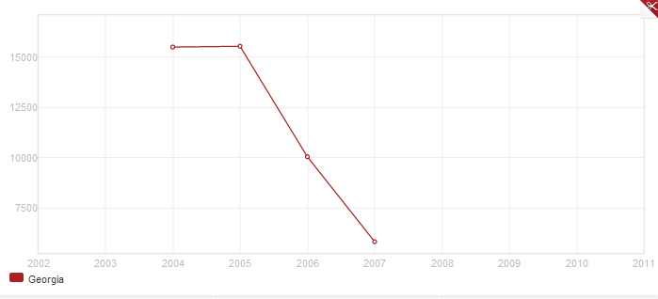
Children not enrolled in school (male + female)

Slide 3
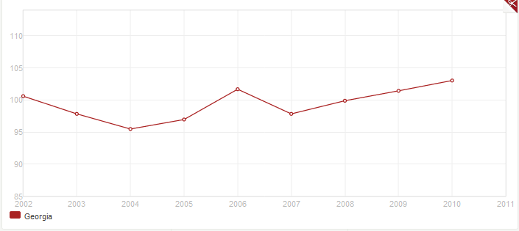
Ration of male to female enrolled in primary education

Slide 4
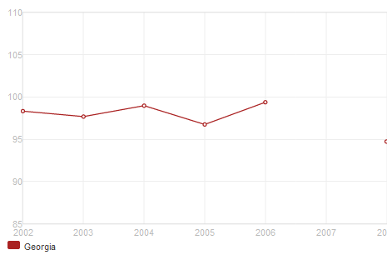
Ration of male to female enrolled in secondary education

Slide 5
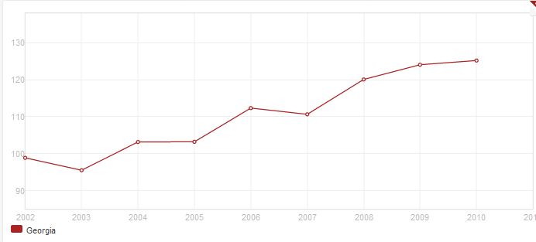
Ration of male to female enrolled in tertiary education

