Slide 1
Education For All
Georgia

Slide 2
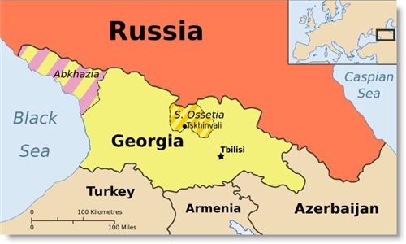
Georgia- location
Located in Eurasia
Grid reference 41̊ 43’N - 44̊ 47’E

Slide 3
Georgia- Facts and figures
2
Area: 69,700 km
Population: 4.6 million (2011)
GDP per capita: $2,629
Density: 68.1 people per square km
Literacy rate: 100%
Capital: Tbilisi
Number of districts: 69

Slide 4
Type of Education
Academic year: September to June
Languages of Instruction: Georgian, Russian
4 stages: Pre-primary, Primary, Secondary, Tertiary
Grading system: 1-5

Slide 5
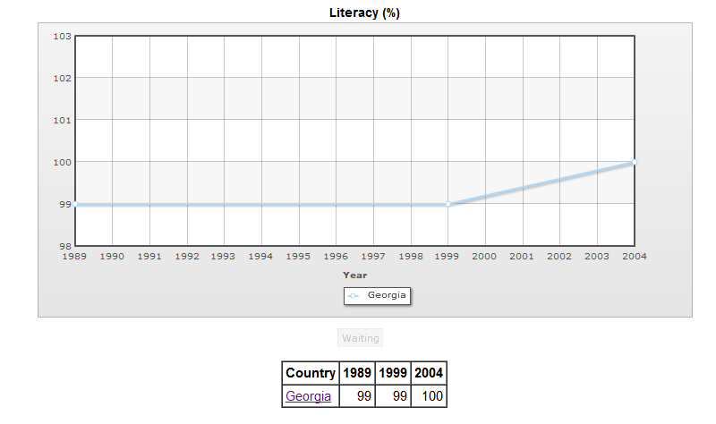

Slide 6
Few statistics

Slide 7
What has government done?
Provided finance help
Provided subsidies on public transport, food etc.
Provide scholarships
Introduced a new subject called: civic education in Georgia
Spread awareness

Slide 8
Bibliography
Employablity_georgia.pdf
enpi_csp_georgia_en.pdf
http://www.friends-partners.org/oldfriends/telecomm/nato/georgia.html
http://www.culturalpolicies.net/web/georgia.php?aid=424&cid=1180&lid=en&curl=833
http://www.culturalpolicies.net/web/georgia.php?aid=833

Slide 9
