Slide 1
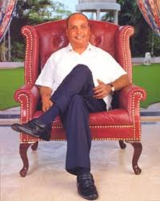
Dhirubhai Ambani
“ Think big, think fast, think ahead. Ideas are no one's monopoly ”

Slide 2
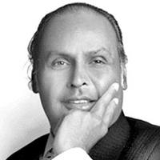
Introduction To Dhirubhai
Dhirubhai Ambani alias Dhirajlal Ambani
Born on December 28, 1932 in Chorwad, Gujarat. And Died on 6th July 2002
Father’s name: Hirachand Ambani (A School teacher)
Mother’s name: Jamnaben Ambani (A house Wife)

Slide 3
Life History
Got educated till 12th grade but due to lack of funds he couldn’t study further
So Dhirubhai started to sell bhajiyas to pilgrimers off mount Girnar
As his father was unwell and couldn't work any more he told his son that you have to earn more than you are earning now. Your brother(Ramnikbhai) has arranged Job for you in Aden

Slide 4
On reaching Aden, Dhirubhai joined office on the very day of his arrival. It was a clerk's job with the A. Besse & Co., named after its French founder Antonin Besse. Those days Aden was the second busiest trading and oil bunkering port in the world after London handling over 6,300 ships a year.
At Aden Dhirubhai learnt how to do business, accounts, bookkeeping , and all other business skills
As the company he worked in built a new harbor for distribution of oil in shell he was promoted to work their. And one fine day he dreamt of HAVING A REFINERY OF HIS OWN
The company in which Dhirubhai worked was engaged in almost every branch of trading business - cargo booking, handling, shipping, forwarding, and wholesale merchandising. Besse acted as trading agents for a large number of European, American, African and Asian companies and dealt with all sorts of goods ranging from sugar, spices, food grains and textiles to office stationery, tools, machinery and petroleum products. Dhirubhai was first sent to the commodities trading section of the firm. Later, he was transferred to the section that handled petroleum products for the oil giant Shell.

Slide 5
Now Dhirubhai Ambani had enough money to start his own business in India and so he felt that India was calling me though having a dream of opening a shop in London
During this period, Dhirubhai and his family used to stay in a one-bedroom apartment at the Jai Hind Estate in Bhuleshwar, Mumbai. In 1965, Champaklal Damani and Dhirubhai Ambani ended their partnership and Dhirubhai started on his own.
In 1968, he moved to an upmarket apartment at Altamont Road in South Mumbai.
Started "Majin" in partnership with Champaklal Damani, his second cousin, who used to be with him in Aden, Yemen. Majin was to import polyester yarn and export spices to Yemen. The first office of the Reliance Commercial Corporation was set up at the Narsinatha Street in Masjid Bunder. It was a 350 sq ft room with a telephone, one table and three chairs. Initially, they had two assistants to help them with their business.

Slide 6
Sensing a good opportunity in the textile business, Dhirubhai Ambani, along with Amit Mehra, a Delhi-based chartered accountant and company secretary residing in Ashok Vihar, Delhi, started the first textile mill at Naroda, in Ahmedabad in the year 1966. Textiles were manufactured using polyester fiber yarn.
Dhirubhai started the brand "Vimal", which was named after his elder brother Ramaniklal Ambani's son, Vimal Ambani. Extensive marketing of the brand "Vimal" in the interiors of India made it a household name. Franchise retail outlets were started and they used to sell "only Vimal" brand of textiles.
In the year 1975, a Technical team from the World Bank visited the Reliance Textiles' Manufacturing unit. This unit has the rare distinction of being certified as "excellent even by developed country standards" during that period. Amit Mehra had played a pivotal role in helping and supporting Dhirubhai in this success

Slide 7
Now their 2 sons Mukesh bhai and Anil bhai were big enough to handle and diversify the business.
Though his right had was paralyzed he had the same vigor and kind of dreams to succeed!
On 6th July he got an another severe Stroke which laid him dead
Dhirubhai had a severe stroke and were admitted in hospital and remained in comma for 10 days and when he came out of comma he had got his right hand paralyzed

Slide 8
Statistics about Reliance

Slide 9
Other enterprising skills in Dhirubhai

Slide 10
9 things to learn from Dhirubhai
“Don't give up, courage is my conviction”

Slide 11
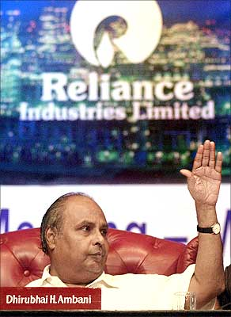
Dhirubhaism No 1: Roll up your sleeves and help.
sense of ‘do it yourself’
He does not wait for infrastructure to be created to support his operations. He goes out and builds it himself; be it a power plant for his petrochemical enterprise or a canal to bring water from large distances for his cooling plant.

Slide 12
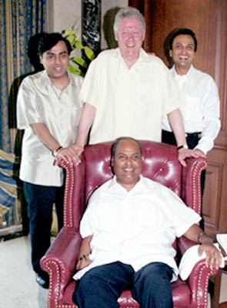
Dhirubhaism No 2: Be a safety net for your team.
There used to be a time when our agency Mudra was the target of some extremely vicious propaganda by our peers,
knowledge that he knew and cared for what his team was going through, and that he was there for Them if needed him, worked wonders for confidence.

Slide 13
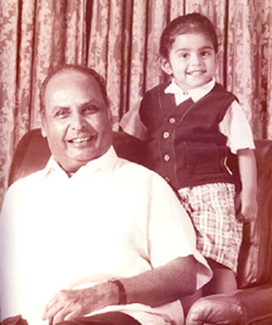
Dhirubhaism No 3: The silent benefactor.
When he helped someone, he never ever breathed a word about it to anyone else
"Expect the unexpected" just might have been coined for him.

Slide 14
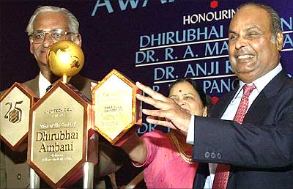
Dhirubhaism No 4: Dream big, but dream with your eyes open.
"It's difficult but not impossible!"
Whenever a task seemed too big to be accomplished, he would reply: " No is no answer!" Not only did he dream big, he taught all of us to do so too.
his favorite phrase "dream with your eyes open"

Slide 15
5. Dhirubhaism: Leave the professional alone!
management techniques of him is different
the simplest strategies are often the hardest to adopt.
“let professionals do the work”
This technique enforced responsibility among his team
"Produce your best."

Slide 16
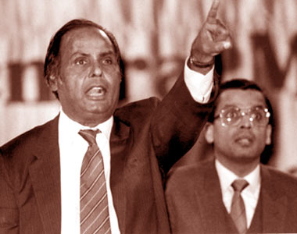
6. Dhirubhaism: Change your orbit, constantly!
Dhirubhai's "orbit theory."
This is no miracle.
when you change orbits, you will create friction. The good news is that your enemies from your previous orbit will never be able to reach you in your new one. By the time resentment builds up in your new orbit, you should move to the next level. And so on.
Changing orbits is the key to
our progress as a nation.

Slide 17
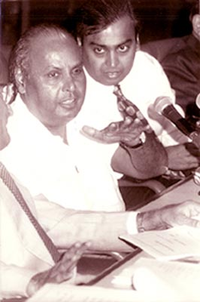
7. The arm-around-the-shoulder leader
It was Dhirubhai's very own signature style
Arm around the shoulder -With that one simple gesture, he managed to achieve many things.
This tendency that he had, to draw people towards him, manifested itself in countless ways.

Slide 18
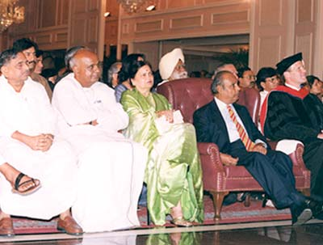
8. The Dhirubhai theory of Supply creating Demand
He was not an MBA. Nor an economist. But yet he took traditional market theory and stood it on its head. And succeeded.
when everyone in India would build capacities only after a careful study of market, he went full steam ahead and created giants of manufacturing plants with unbelievable capacities.

Slide 19
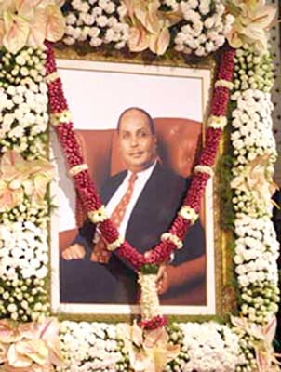
9. Money is not a product by itself, it is a by-product, so don't chase it
He did not breathe a word about profits, nor about becoming the richest
A by-product is something that you don't set out to produce. It is the spin off when you create something larger.

Slide 20
Awards Received by him
October 2011 - Awarded posthumously the 'ABLF Global Asian Award' at the Asian Business Leadership Forum Awards
November 2000 – Conferred "Man Of The Century" award by Chemtech Foundation and Chemical Engineering
World in recognition of his outstanding contribution to the growth and development of the chemical industry in India
2000, 1998 and 1996 – Featured among "Power 50 - the most powerful people in Asia" by Asia week magazine.
June 1998 - "Dean's Medal" by The Wharton School, University of Pennsylvania, for setting an outstanding example of leadership. Dhirubhai Ambani has the rare distinction of being the first Indian to get Wharton School Dean's Medal
August 2001 – Economic Times Awards for Corporate Excellence for Lifetime Achievement.
Dhirubhai Ambani was named the "Man of 20th Century" by the Federation of Indian Chambers of Commerce and Industry (FICCI).
A poll conducted by The Times of India in 2000 voted him "Greatest Creator of Wealth In The Centuries".

