Slide 2
Introduction to Co-founders
John Warnock
Charles geschke
Bachelor of science in mathematics and philosophy
Ph.D. in electrical engineering
Master of Science in mathematics
CEO of adobe (retired in 2001)
Bachelor of arts in classics
Ph.D. in computer science
Master of Science in mathematics
CEO of adobe ()

Slide 3
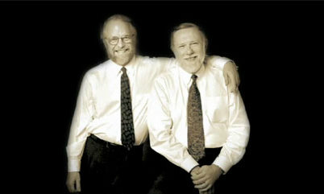
John and Charles
Co founders of Adobe

Slide 4
Journey
Mr. John and Mr. Charles use to work in XEROX PARC. They proposed the company to commercialize the interpress graphics language for controlling the printing but the company refused their proposal. So John and Charles left the company.
At this time they were around 40. John and Charles both had a great support from family. They were untrained businessman. So Mr. William Hambrecht hired a men for them who would help them and guide them to start the business. Mr. Hambrecht gave them $50,000 to start the business.
In 1982,They both decided to give the company name Adobe. The Logo of the company was designed by Marva Warnock.

Slide 5
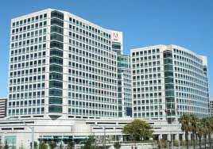
In 1983 Adobe got its first postscript license and introduced postscript for apple printers. At the end of year adobe had revenue of $83,000 and had 13 employees
Soon the company started to make many products such as Photoshop, Adobe reader, Acrobat and etc.
Now it has introduced more than 150 products in the market.
And Now It One Of The Highest Earning Companies Of The World
In 1988 adobe introduced Adobe Illustrator as a competitor to Apples MacDraw. It had many functions unlike the MacDraw.
In 1996 company moved in San Jose world Head quarters

Slide 6
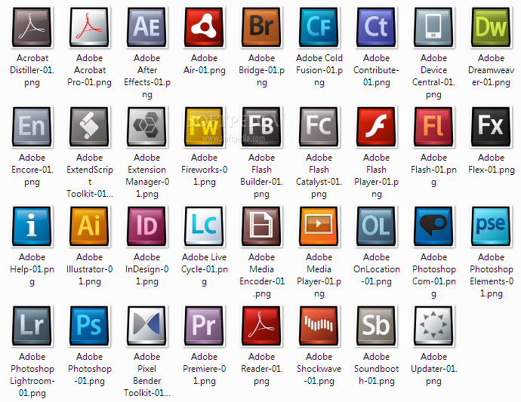
FEW Products

Slide 10
THANK YOU

